Slide 1
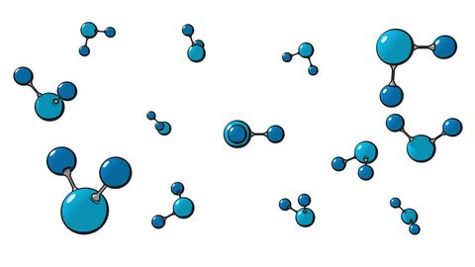
Metabolomics meeting with Nav and Ram
05.16.2022

Slide 2
Metabolomic comparison of genetically manipulated ALS model using Drosophila whole larvae
dSod1^{G85R} knock-in model of ALS
exhibit motor dysfunction, defects in NMJ, and in distribution and function of mitochondria, shortened lifespan
pathogenic phenotypes can be rescued via genetic manipulation of metabolic pathways
here we are looking at the PPP enzyme transketolase (Tkt)
~10⁵ neurons in Drosophila CNS
Choline acetyltransferase (ChAT/Cha) expression marks cholinergic neurons (acetylcholine as neurotransmitter):
sensory and interneurons
Cha-Gal4 expressed in 6 X 10⁴ neurons
Shown that overexpression of tkt (UAS-tkt) in cholinergic neurons (Cha-Gal4) can suppress multiple pathogenic phenotypes
Genotypes to be tested:
Control Cha-Gal4/+ ; dSod1^{WT}
ALS model Cha-Gal4/+ ; dSod1^{G85R}
Control, OE tkt in WT background Cha-Gal4/+ ; UAS-Tkt/+; dSod1^{WT}
OE tkt suppression of ALS Cha-Gal4/+ ; UAS-Tkt/+; dSod1^{G85R}
Control, tkt LOF in WT background Cha-Gal4/+ ; Df-8143(tkt)/+; dSod1^{WT}
tkt LOF suppression of ALS Cha-Gal4/+ ; Df-8143(tkt)/+; dSod1^{G85R}
Notes:
Identifying the cholinergic fate was challenging because unlike VGlut and gad1 reporters, the ChAT reporters labeled many non-cholinergic neurons in addition to cholinergic neurons (Figure 7—figure supplement 1; also see below). Thus, we relied on ChAT antibody staining and identified 14 cholinergic hemilineages: 1A, 3A, 4B, 7B, 8B, 10B, 11A, 12A, 17A, 18B, 19B, 23B, 20/22A (Figure 6N). From DOI: https://doi.org/10.7554/eLife.43701.001
ChAT-Gal4 BDSC_60317
See also https://doi.org/10.1016/j.celrep.2019.12.018

Slide 3
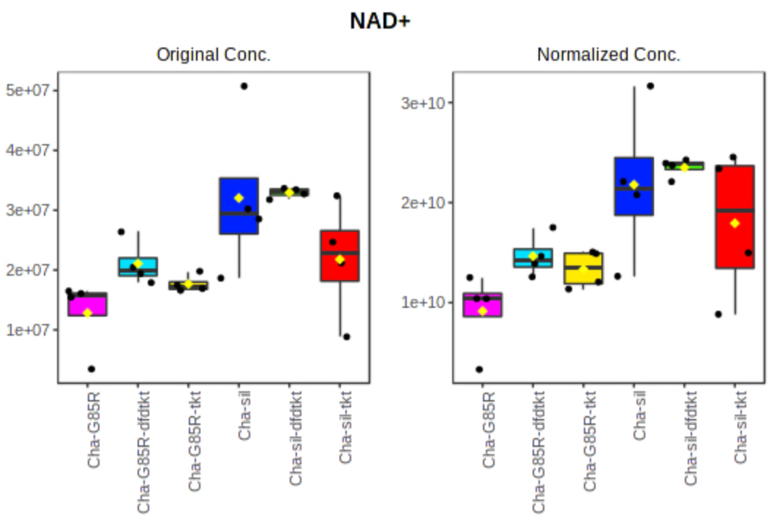
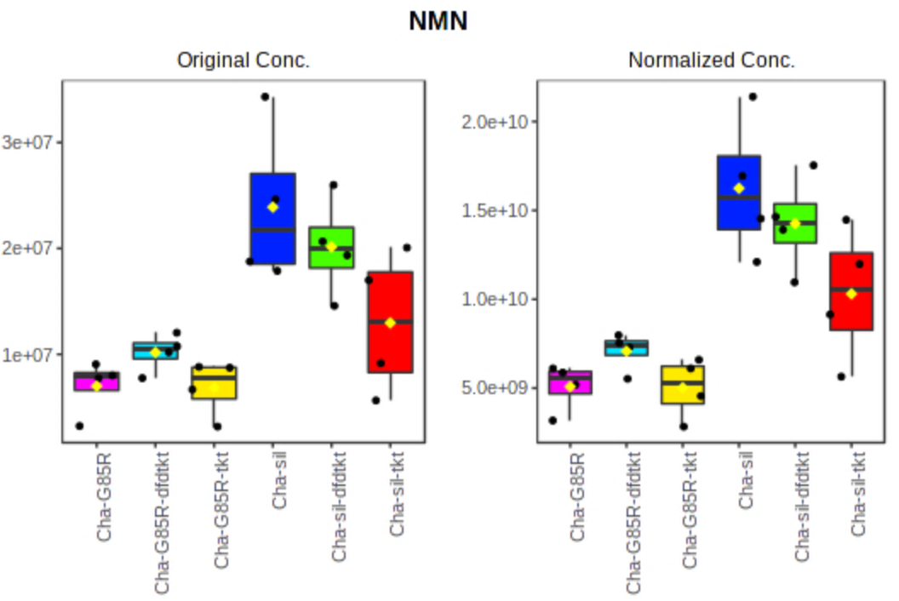
Pathway analysis: all data
G85R
G85R – tkt LOF
G85R – tkt-OE
WT
WT – tkt LOF
WT – tkt-OE
G85R
G85R – tkt LOF
G85R – tkt-OE
WT
WT – tkt LOF
WT – tkt-OE
controls
controls
G85R
G85R – tkt LOF
G85R – tkt-OE
WT
WT – tkt LOF
WT – tkt-OE
G85R
G85R – tkt LOF
G85R – tkt-OE
WT
WT – tkt LOF
WT – tkt-OE
controls
controls

Slide 4
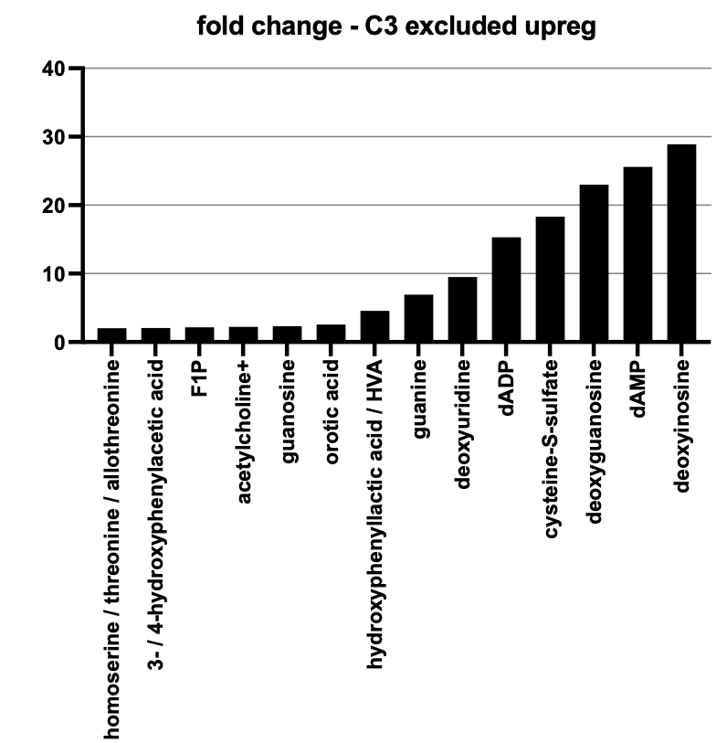
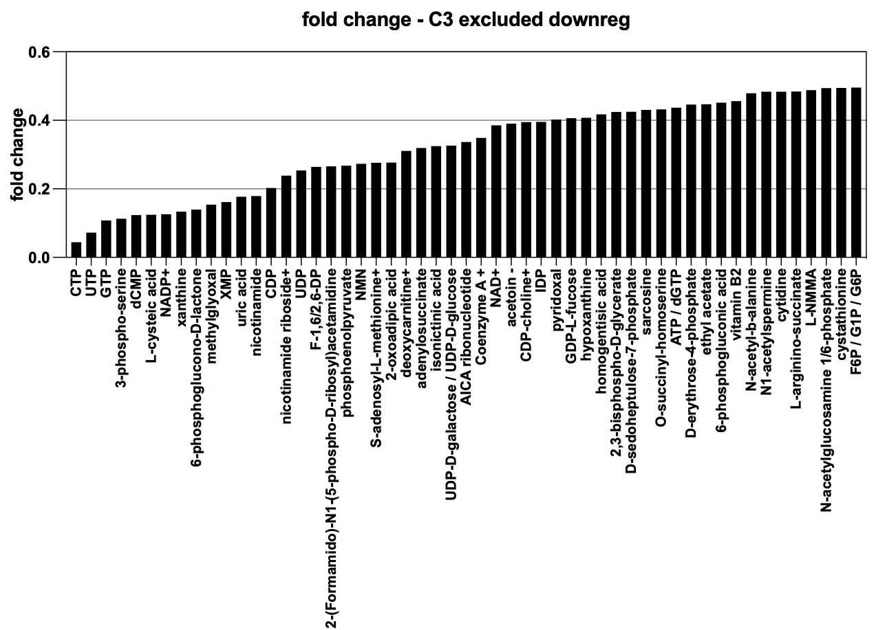
Metabolite analysis comparing dSod1^{WT} and dSod1^{G85R}

Slide 5
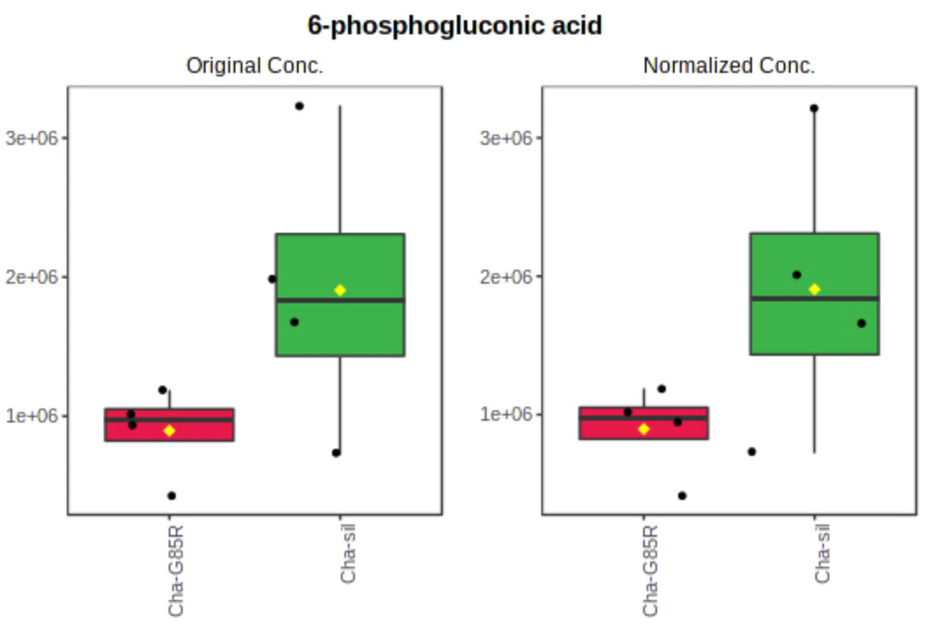
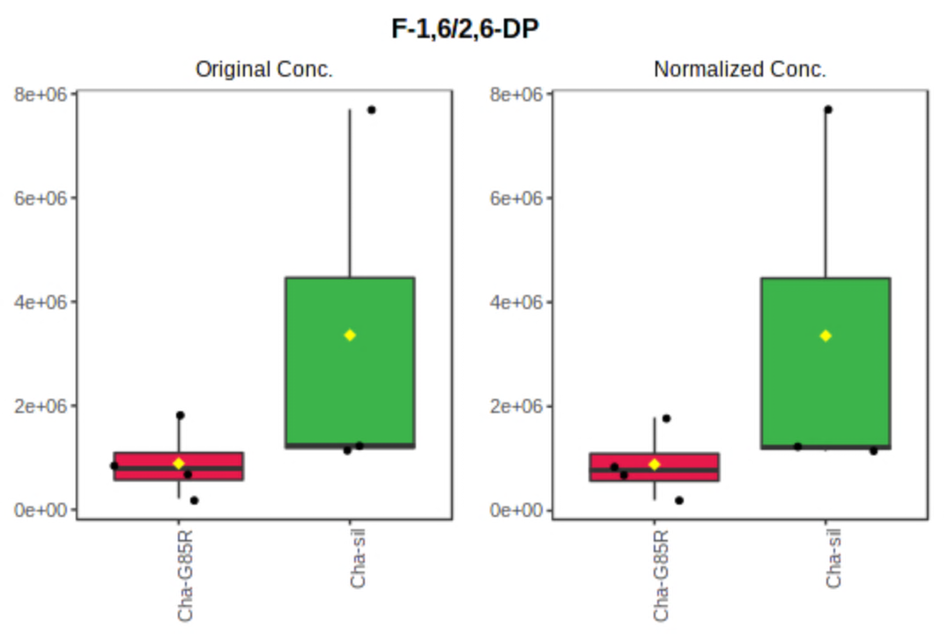
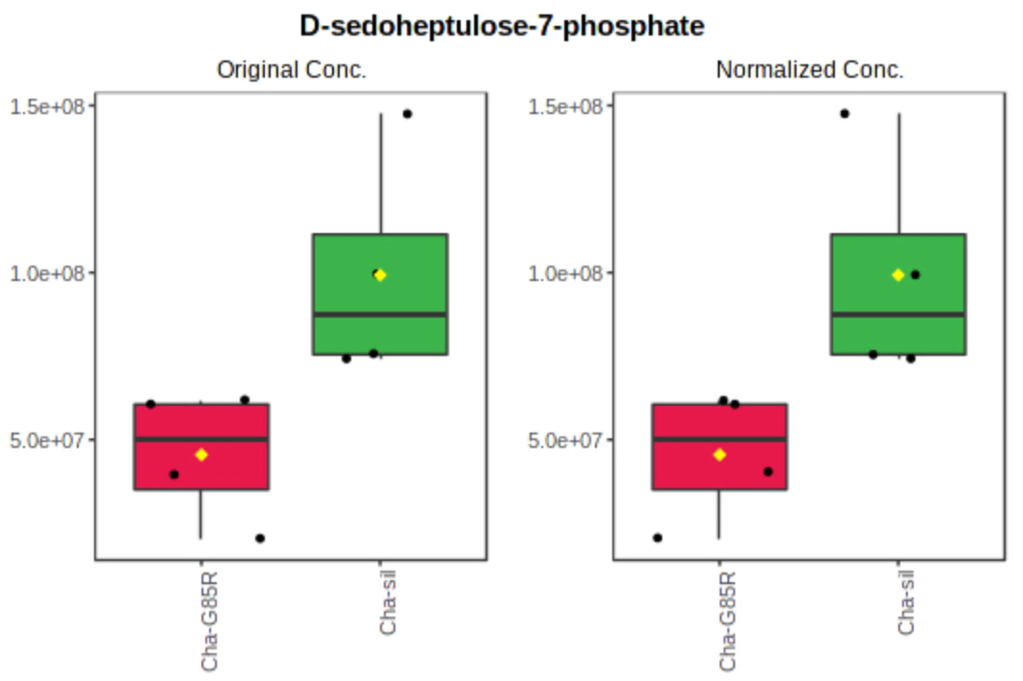
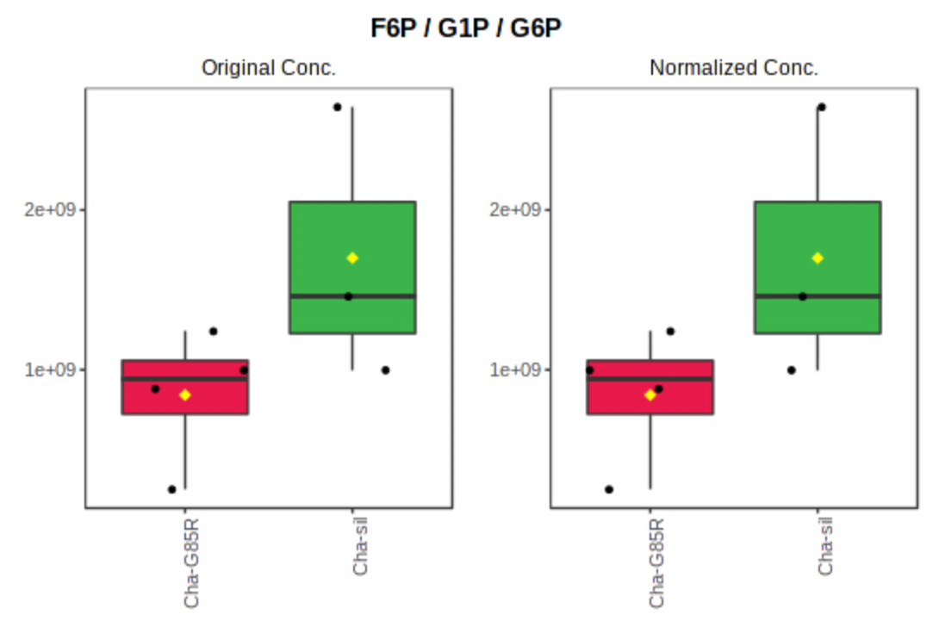
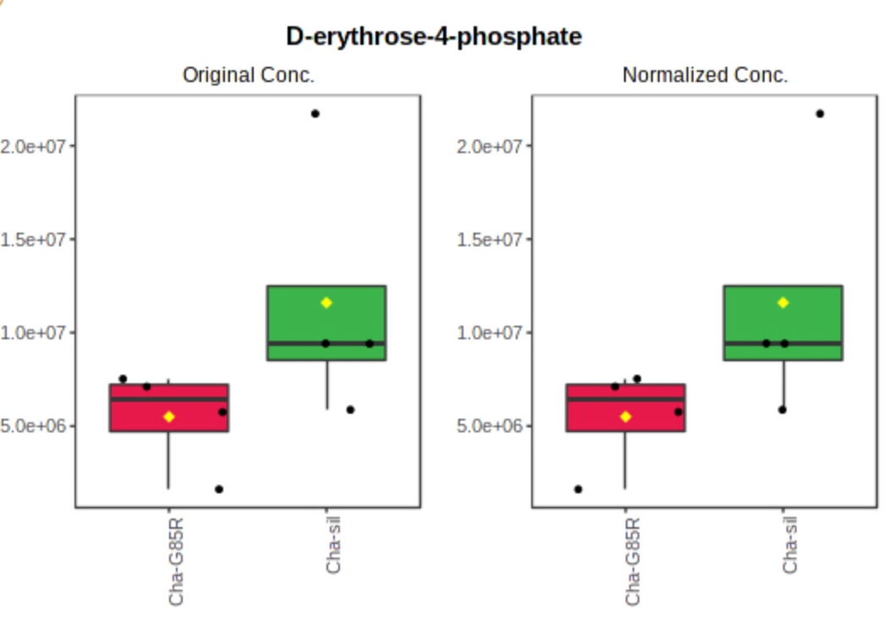
Metabolite analysis comparing dSod1^{WT} and dSod1^{G85R}
Notes:
We also see decreases in succinate in G85R, which is found in the krebs cycle and links succicinate dehydrogenase (complex II) to the krebs cycle. This would make sense if there are increases in succinate dehydrogenase activity in the system. Also, alpha ketoglutarate and acetyl-coa is down.

Slide 6
Metabolite analysis: metabolites not rescued by Tkt or Tkt-def
 | f.value | p.value | Sil vs G diff? | Rescued by Tkt | Rescued by Tkt-Df | Rescued by both Tkt and Tkt-Df
uric acid | 276.3 | 2.46E-11 | YES | NO | NO | NO
b-alanine | 39.783 | 1.64E-06 | YES | NO | NO | NO
nicotinamide riboside+ | 36.67 | 2.54E-06 | YES | NO | NO | NO
xanthine | 36.186 | 2.73E-06 | YES | NO | NO | NO
deoxycarnitine+ | 30.886 | 6.33E-06 | YES | NO | NO | NO
deoxyguanosine | 24.292 | 2.20E-05 | YES | NO | NO | NO
NMN | 21.205 | 4.35E-05 | YES | NO | NO | NO
deoxyinosine | 20.84 | 4.75E-05 | YES | NO | NO | NO
dAMP | 18.627 | 8.24E-05 | YES | NO | NO | NO
guanine | 18.588 | 8.33E-05 | YES | NO | NO | NO
phosphorylcholine+ | 15.511 | 0.00019769 | YES | NO | NO | NO
3-phospho-serine | 11.15 | 0.00087372 | YES | NO | NO | NO
acrylic acid | 8.4833 | 0.0027025 | YES | NO | NO | NO
3-hydroxykynurenine | 7.1967 | 0.0050756 | YES | NO | NO | NO
cytidine | 7.0377 | 0.0055126 | YES | NO | NO | NO
Green metabolites are upregulated in G85R vs silent
YES | NO | ENHANCED DEFECT | N/A | TREND
 | f.value | p.value | Sil vs G diff? | Rescued by Tkt | Rescued by Tkt-Df | Rescued by both Tkt and Tkt-Df
dADP | 10.595 | 0.0010868 | YES | NO | ENHANCED DEFECT | NO
agmatine | 46.579 | 6.93E-07 | NO | ENHANCED DEFECT | ENHANCED DEFECT | N/A
dehydroascorbic acid | 7.7881 | 0.0037682 | NO | N/A | ENHANCED DEFECT | N/A
2-aminobutanoate / 2-/3-aminoisobutanoate | 7.647 | 0.0040405 | NO | N/A | ENHANCED DEFECT | N/A
D-sedoheptulose | 7.5216 | 0.0043017 | NO | ENHANCED DEFECT | ENHANCED DEFECT | N/A

Slide 7
Metabolite analysis: metabolites rescued by OE-tkt only
 | f.value | p.value | Sil vs G diff? | Rescued by Tkt | Rescued by Tkt-Df | Rescued by both Tkt and Tkt-Df
homoserine / threonine / allothreonine | 36.009 | 2.80E-06 | YES | YES | NO | NO
glutamine | 23.462 | 2.62E-05 | YES | YES | NO | NO
pyrroline hydroxycarboxylic acid | 19.779 | 6.15E-05 | YES | YES | NO | NO
asparagine | 11.125 | 0.00088203 | YES | YES | ENHANCED DEFECT | NO
glycine | 13.4 | 0.00038784 | YES | TREND | NO | NO
N-acetylaspartic acid | 11.837 | 0.00067376 | YES | TREND | NO | NO
2-oxoadipic acid | 9.0879 | 0.0020525 | YES | TREND | NO | NO
AICA ribonucleotide | 9.1995 | 0.0019535 | YES | TREND | ENHANCED DEFECT | NO
Green metabolites are upregulated in G85R vs silent

Slide 8
Metabolite analysis: metabolites rescued by Tkt-Df (LOF) only
 | f.value | p.value | Sil vs G diff? | Rescued by Tkt | Rescued by Tkt-Df | Rescued by both Tkt and Tkt-Df
dCMP | 19.874 | 6.00E-05 | YES | NO | YES | NO
N-acetylaspartic acid | 12.002 | 0.00063395 | YES | NO | YES | NO
D-ribose-1/5-phosphate / D-ribulose 5-phosphate | 7.1545 | 0.0051873 | YES | NO | YES | NO
N-acetyl-L-glutamic acid | 12.56 | 0.00051857 | YES | ENHANCED DEFECT | YES | NO
Metabolite analysis: metabolites rescued by both
 | f.value | p.value | Sil vs G diff? | Rescued by Tkt | Rescued by Tkt-Df | Rescued by both Tkt and Tkt-Df
hydroxyphenyllactic acid / HVA | 10.976 | 0.00093491 | YES | TREND | TREND | TREND
guanosine | 7.7069 | 0.0039222 | YES | TREND | TREND | TREND

Slide 9
C= Cha-Gal4/+; silent/silent
E= Cha-Gal4/+; G85Rcr/G85Rcr
A= Cha-Gal4/+; UAS-Tkt-silent/silent
F= Cha-Gal4/+; UAS-Tkt-G85Rcr/G85Rcr
B= Cha-Gal4/+; Df-8143(tkt) silent/silent
D= Cha-Gal4/+; Df-8143(tkt) G85Rcr/G85Rcr

